Slide 1

Microsoft Excel 2013
Dr. Wameedh. T.M. Al-Tameemi

Slide 2
Excel 2013 INTRODUCTION
Microsoft Excel is a powerful electronic spreadsheet program you can use to automate accounting work, organize data, and perform a wide variety of tasks. Excel is designed to perform calculations, analyze information, and visualize data in a spreadsheet. Also this application includes database and charting features.
Microsoft Excel هو برنامج جداول بيانات إلكترونية قوية يمكنك استخدامها لأتمتة العمل المحاسبي وتنظيم البيانات وتنفيذ مجموعة متنوعة من المهام. تم تصميم Excel لإجراء العمليات الحسابية وتحليل المعلومات وعرض البيانات صوريا على شكل جدول بيانات. أيضا يتضمن هذا التطبيق قاعدة بيانات وميزات الرسم البياني.
Launch Excel
To launch Excel for the first time:
1. Click on the Start button.
2. Click on All Programs.
3. Select Microsoft Office from the menu options, and then click on Microsoft Excel 2013.
Or d.click on Excel icon if you put one on the desktop

Slide 3
Excel 2013 Window Features
The purpose of the window features is to enable the user to perform routine tasks related to the Microsoft applications.
All the Office applications share a common appearance and similar features. The window features provide a quick means to execute commands.

Slide 4
Excel 2013 Window Features
The purpose of the window features is to enable the user to perform routine tasks related to the Microsoft applications.
All the Office applications share a common appearance and similar features. The window features provide a quick means to execute commands.

Slide 5
Excel 2013 Window Features

Slide 6
Excel 2013 Mouse Pointer Styles
The Excel mouse pointer takes on many different appearances as you move around the spreadsheet. The following table summarizes the most common mouse pointer appearances:

Slide 7
Excel 2013 Mouse Pointer Styles
The Excel mouse pointer takes on many different appearances as you move around the spreadsheet. The following table summarizes the most common mouse pointer appearances:

Slide 8
Excel 2013 Spreadsheet Navigation
The following table provides various methods to navigation around a spreadsheet.

Slide 9
Excel 2013 Basic Steps for Creating a Spreadsheet
When creating a spreadsheet it is recommended to do the following steps:
1. Made a draft of your spreadsheet idea on paper.
2. Enter the data from your draft onto the actual spreadsheet.
3. Format your data after entering onto the spreadsheet.
4. Calculate data by using mathematical formulas.
5. Save the document.
6. Preview and Print the spreadsheet.

Slide 10
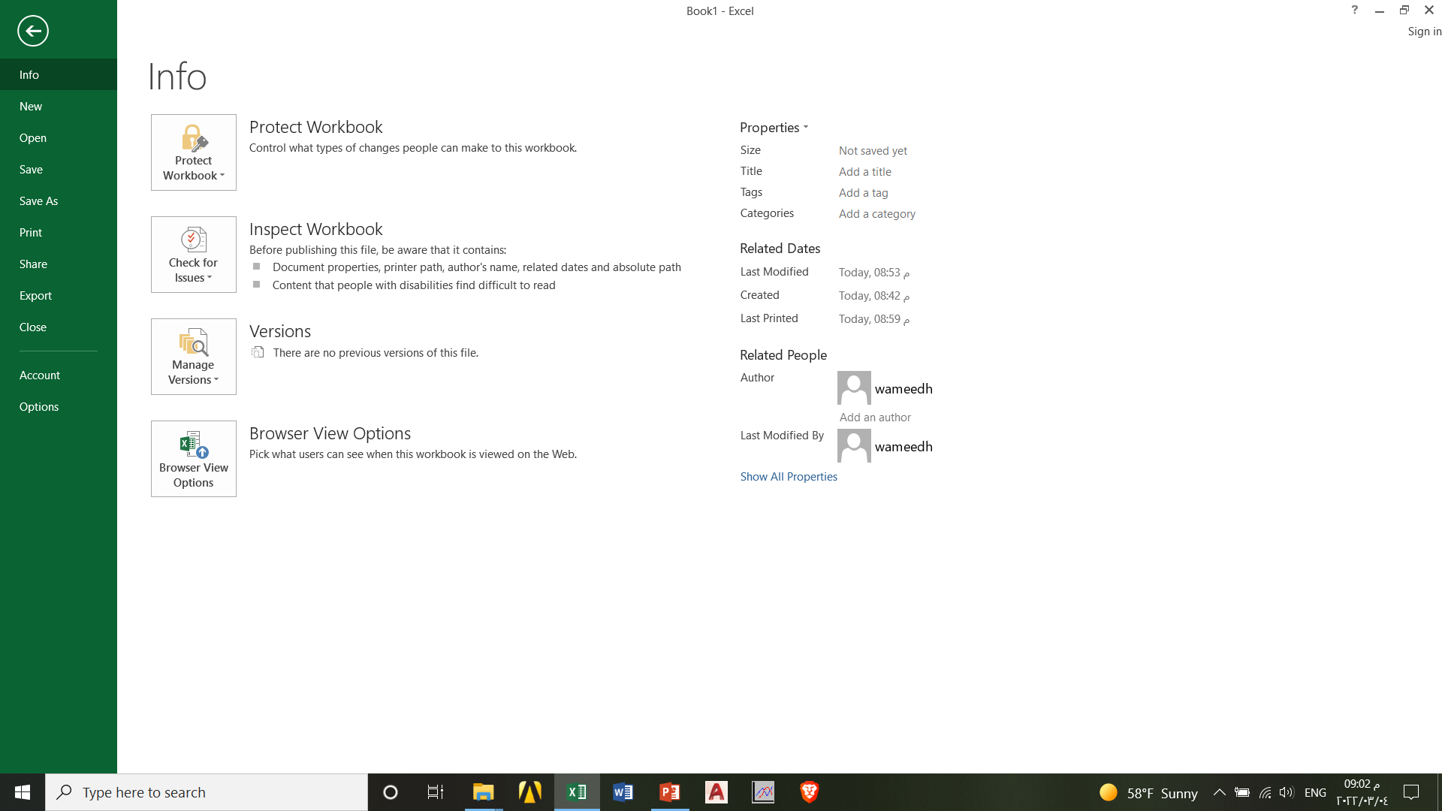
Excel 2013 File Menu-info

Slide 11
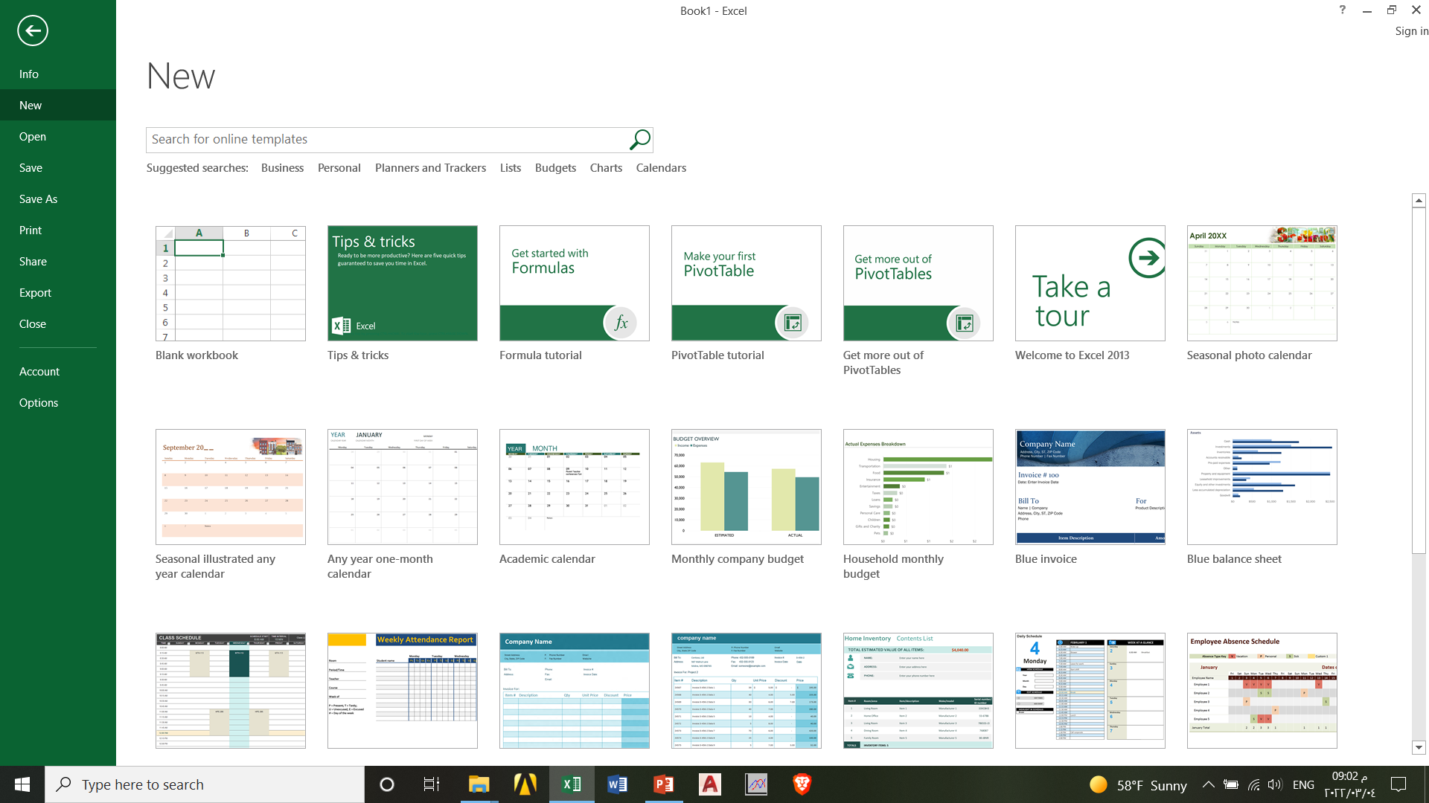
Excel 2013 File Menu-new

Slide 12
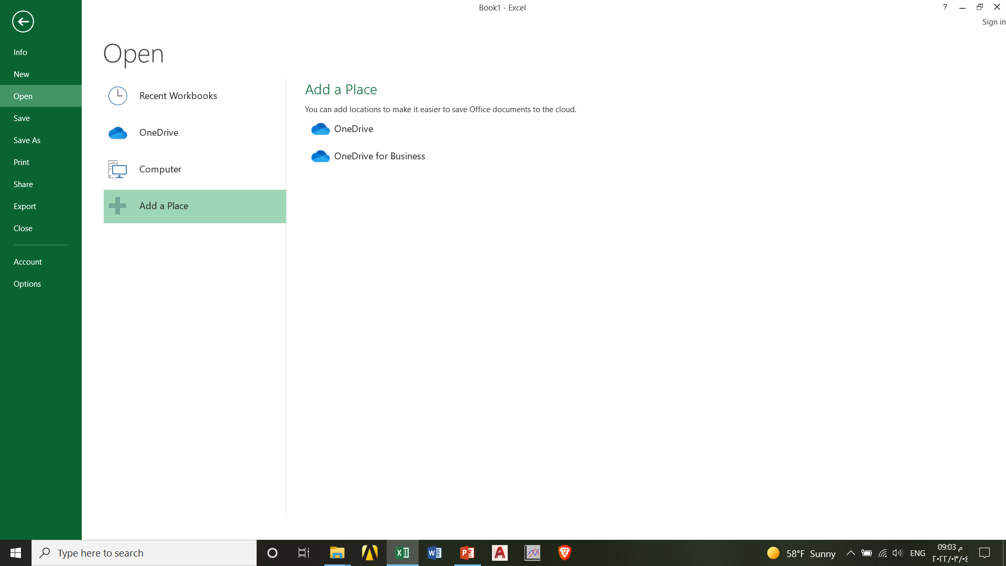
Excel 2013 File Menu-open

Slide 13
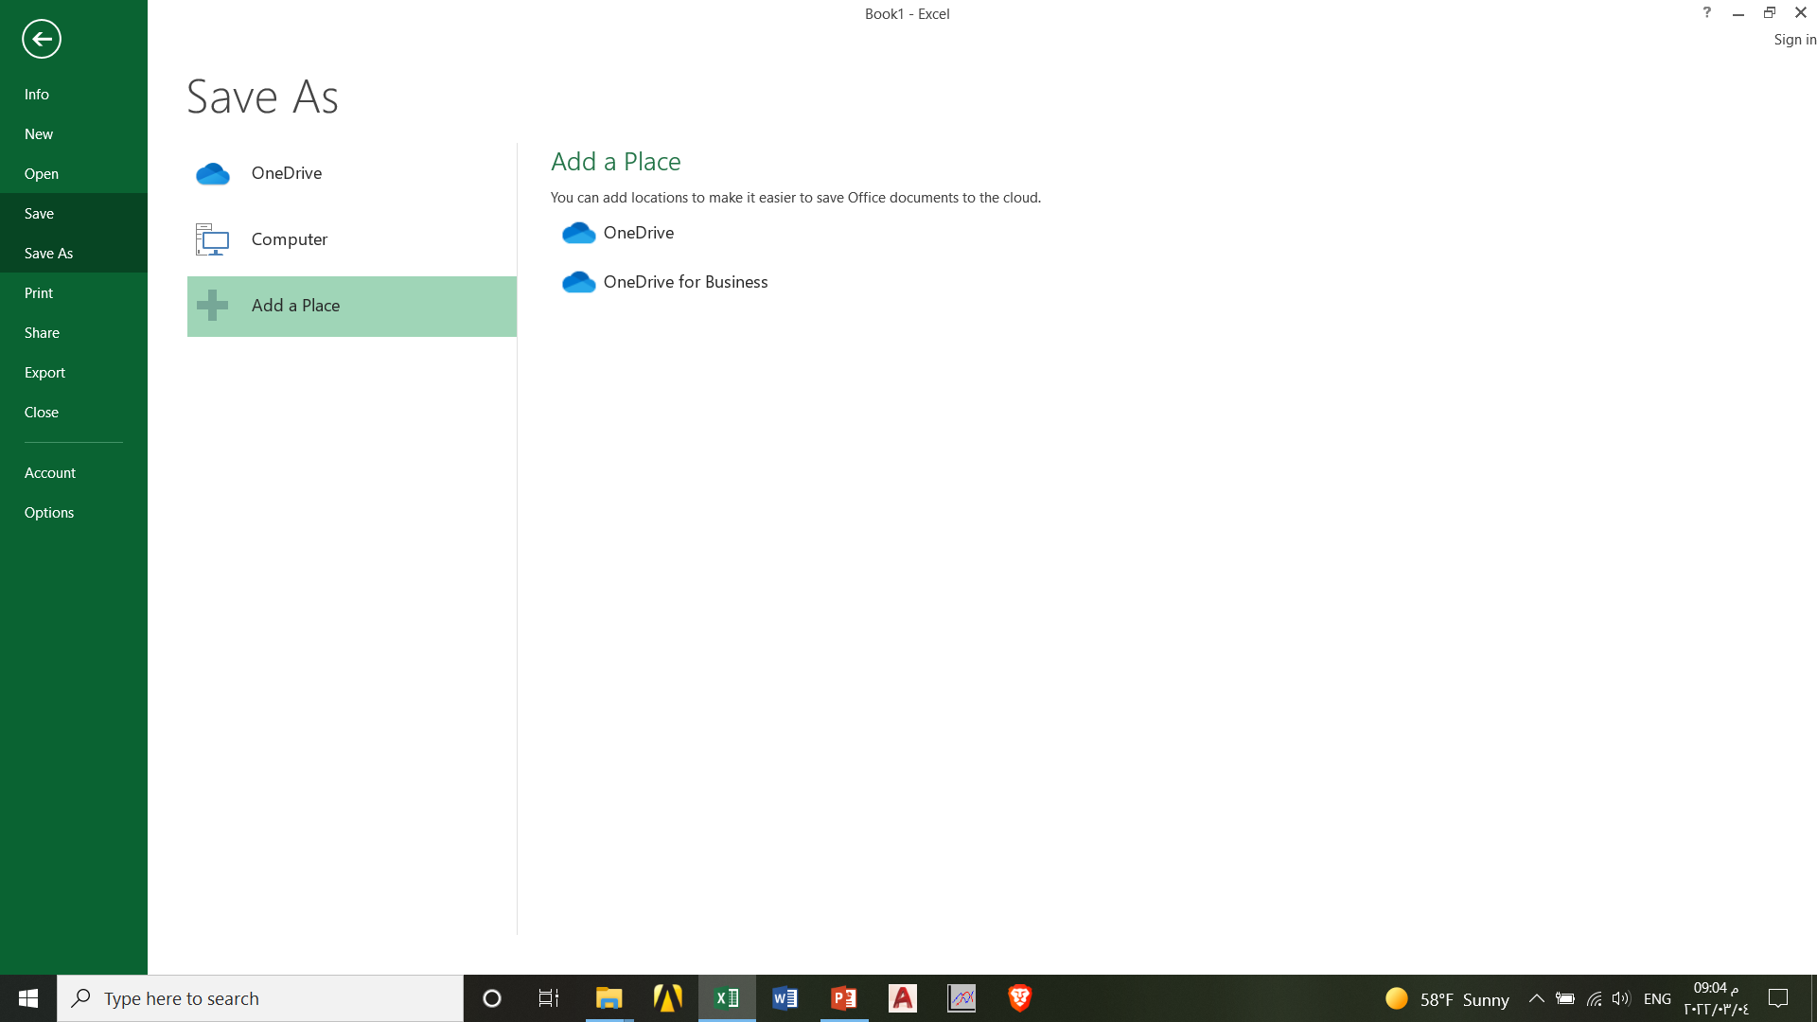
Excel 2013 File Menu-save – save as

Slide 14
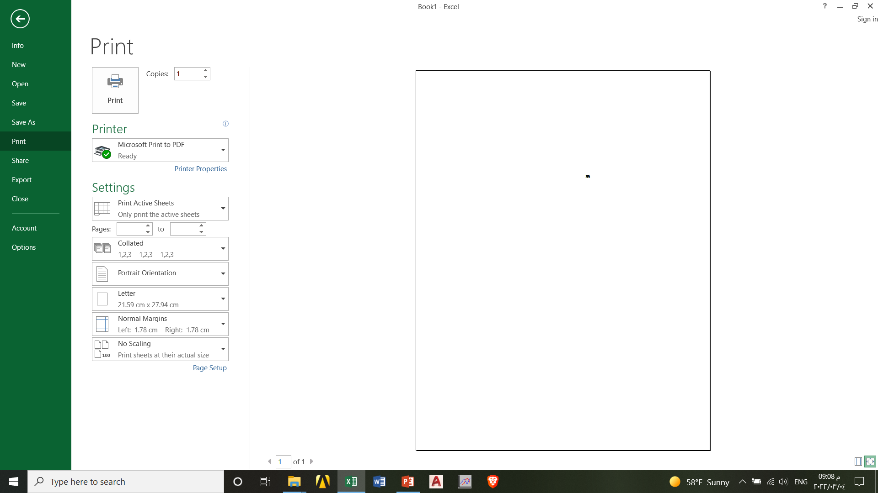
Excel 2013 File Menu-print

Slide 15
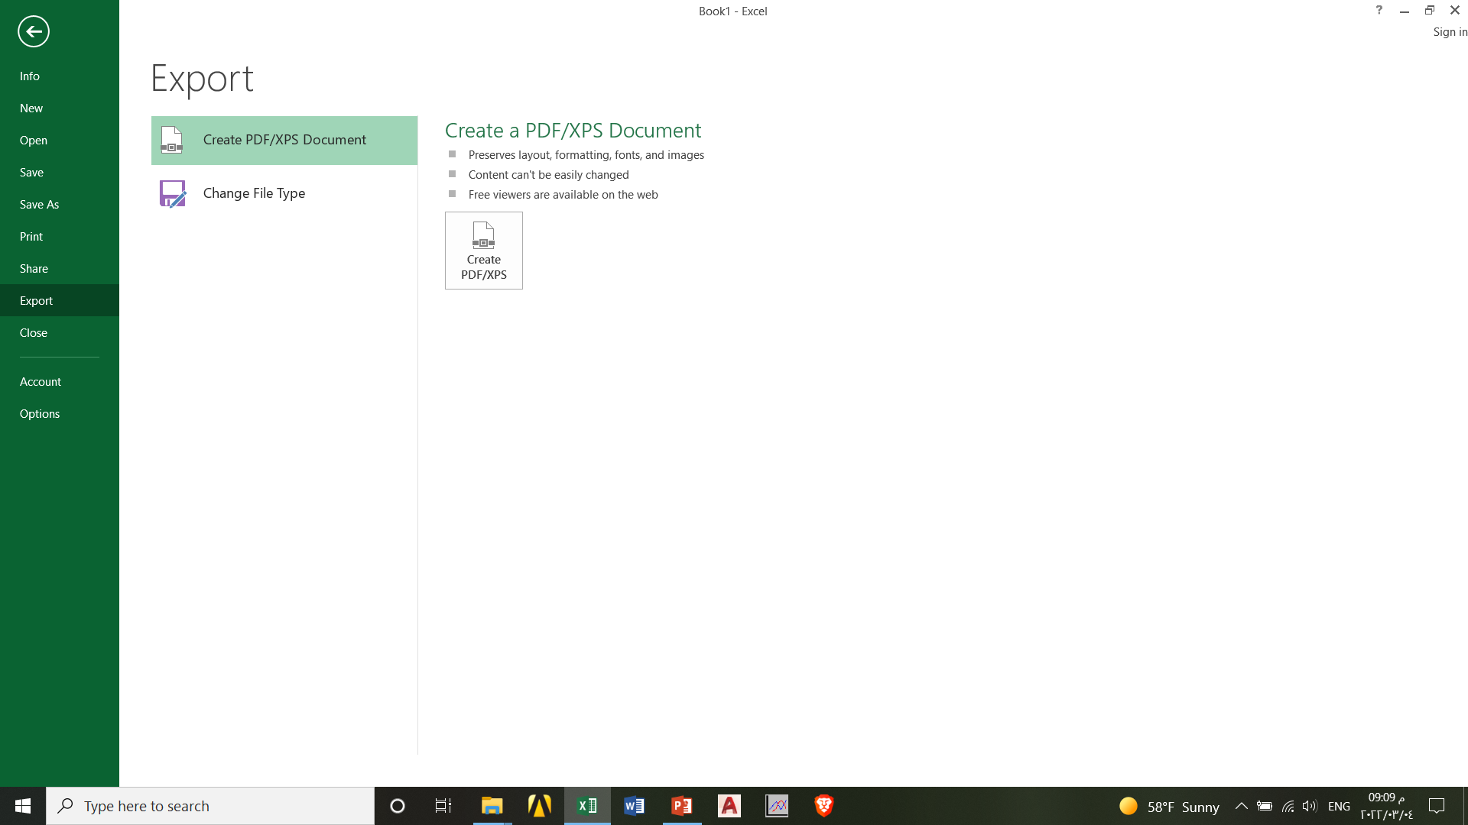
Excel 2013 File Menu-Export

Slide 16
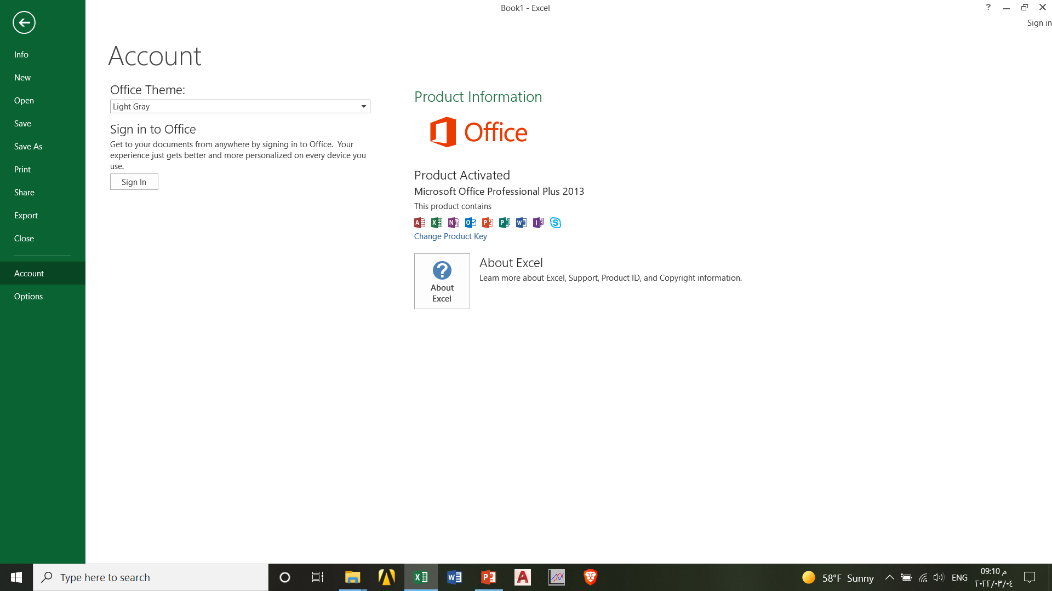
Excel 2013 File Menu-Account

Slide 17
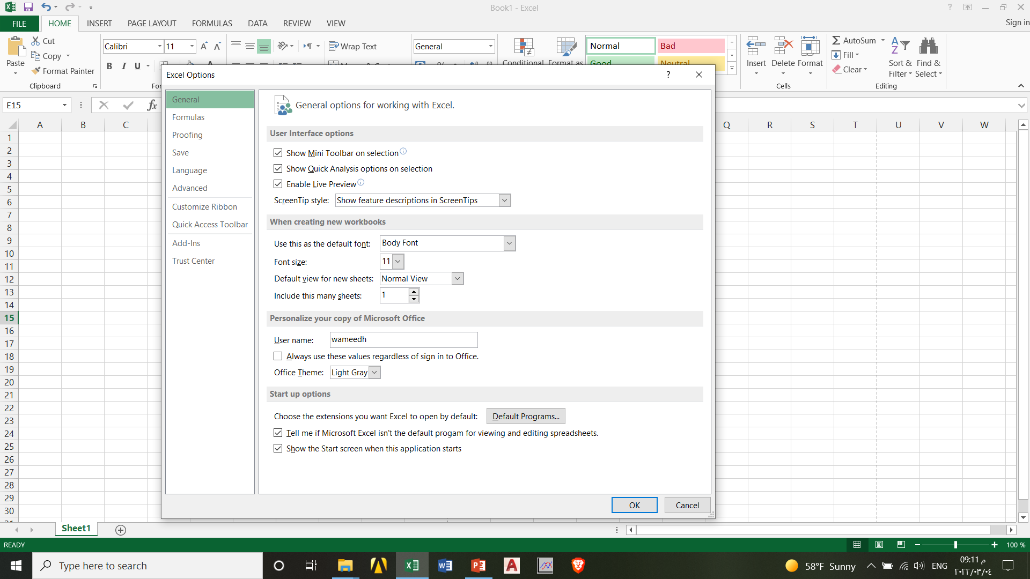
Excel 2013 File Menu-Options

Slide 18
Excel 2013 Next
Next lecture: Editing Data
Thank you very much

